Slide 1


ACT
Overview
English
Math
Reading Science
Optional Writing

Slide 2
Registration and Cost
$52.00 without Writing
$60.00 with Writing
$30.00 Late Fee
$55.00 Standby Testing
$32.00 Test Date Change
Additional Information and Registration at www.actstudent.org

Slide 3

Test Prep
Henry County pays for all Sophomores to take the
Practice ACT at school in the fall.
Use this as an opportunity to learn your strengths and weaknesses.
There are TEST PREP books in the Learning Commons to check out that have tips, strategies, sample questions, etc…CHECK OUT A COPY!!

Slide 4

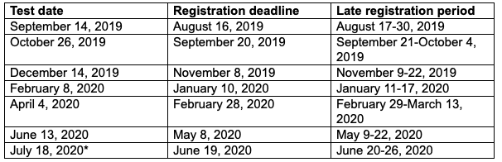
Registration Deadlines and Testing Dates

Slide 5

English
75 Questions
45 minutes to complete this section
Production of Writing (29–32%)
  The questions in this category require students to apply their understanding of the purpose and focus of a piece of writing.
Knowledge of Language (13–19%)
  Demonstrate effective language use through ensuring precision and concision in word choice and maintaining consistency in style and tone
Conventions of Standard English (51–56%)
  The questions in this category require students to apply an understanding of the conventions of standard English grammar, usage, and mechanics to revise and edit text.

Slide 6
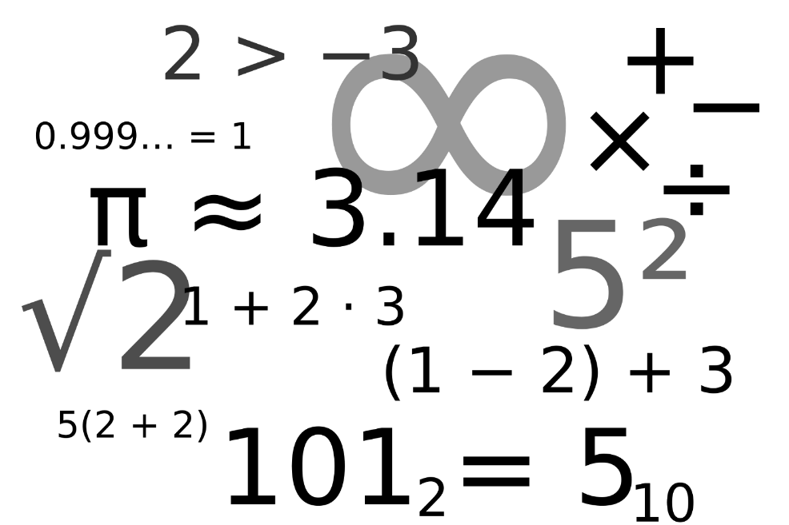
Math
60 questions
60 minutes to complete this section
Math Area | # of Questions
Pre-Algebra | 14
Elementary Algebra | 10
Intermediate Algebra | 9
Geometry | 9
Plane Geometry | 14
Trigonometry | 4

Slide 7

Reading
4 reading passages; 10 questions m/c each
35 minutes to complete this section after a 15 minute break
Type of Question | Examples
Detail Questions | find and interpret details
Main Idea Questions | identify the main idea of a passage, paragraph, or paragraphs
Comparative Relationships Questions | interpret comparative relationships (similarities and differences)
Cause-Effect Relationships Questions | interpret cause and effect relationships
Generalizations Questions | draw generalizations
Vocabulary-in-Context Questions | identify the meaning of words in context
Sequence of Events Questions | determine when events happened and/or the order of events
Author's Voice and Method Questions | identify the author's style, attitude, and point of view; the main purpose of a sentence, a paragraph, or the passage as a whole

Slide 8
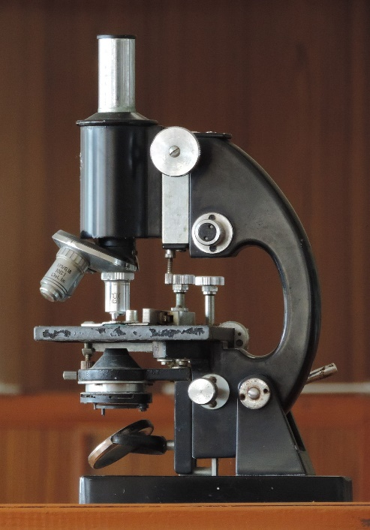
Science
40 questions
35 minutes to complete this section
Biology, Chemistry, Earth/Space Sciences, Physics
Passage Format | Additional Information | % of Questions (# of Questions)
Data Representation | understand, evaluate, and interpret information presented in graphs, tables, or charts | 38% (approx. 15 questions)
Research Summaries | understand, evaluate, and analyze one or more experiments | 45% (approx. 18 questions)
Conflicting Viewpoints | understand and evaluate conflicting viewpoints, theories, or hypotheses on a specific topic | 17% (approx. 7 questions)

Slide 9

Writing
Optional Section
1 essay question
40 minutes to plan, write and edit
Does not affect your subject area scores or you composite score

Slide 10

Format of the ACT Test
ALWAYS in the SAME order:
English – 45 min
Math – 60 min
Break – 10 min
Reading - 35 min
Science – 35 min
Break - 5 min if taking Essay
Optional Essay – 40 min

Slide 11
Why is your ACT Score Important?
The ACT examination assesses high school students’ general educational development and their ability to complete college level work. All colleges and universities in Georgia accept scores from the ACT
for admission purposes.

Slide 12
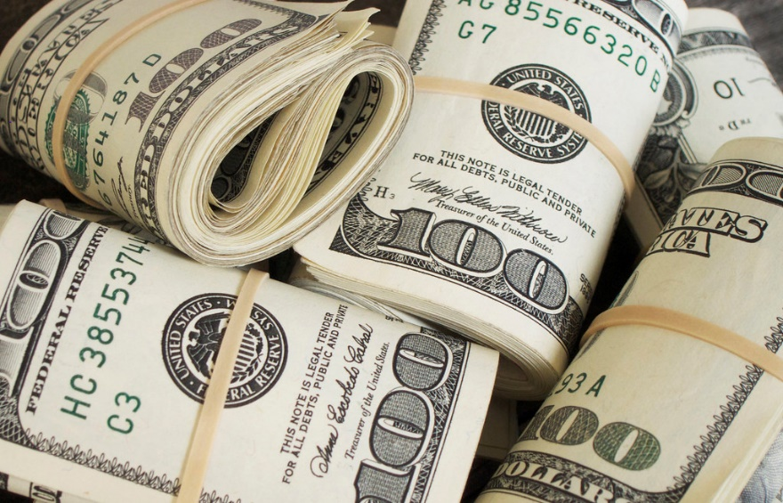
ACT scores Impact Admissions and Scholarship Awards
Many Universitys award merit scholarships
based on GPA and ACT scores.
Some schools award these based on individual subtest scores-not your overall composite score.
It may be to your advantage to retake the test multiple times. It could result in a $10,000 or more difference in scholarship award.

Slide 13

Facts
57% increased their Composite Score
on a second attempt
Schools take your highest score for each section.
The lower you score, the more likely your scores will go up on the second try!

Slide 14
When averaging sub scores, ACT rounds up. Therefore, if your scores average 21.5, you get a 22 on your ACT.
The AVERAGE score on the ACT is a 21.
Many schools require a 25 or higher to be consider for scholarships.

Slide 15
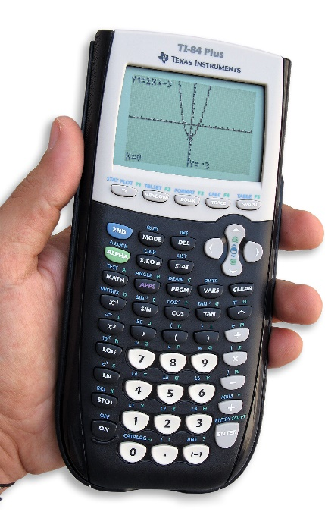
College READINESS Benchmarks as set by ACT
English 18
Math 22
Reading 22
Science 23

